Slide 1
Sales Process Overview SalesforceCPQ
CoE Playbook
October 2016
Confidential

Slide 2
Sales Team
Role | Responsibility
Account Executive (AE) | Manages customer expectations Responsible for managing resources and coordinating activities to progress the sales cycle Delivers the proposal and closes the sale
Sales Engineer (SE)* | Showcases product capability and provides initial design consultation Executes the evaluation path Creates and delivers product demo
Implementation Consultant (IC)* | Secures the design approach, recommends enablement option Executes the Scoping, responsible for producing the Services estimate Scope of Work
Confidential

Slide 3
STEELBRICK SALES STAGES
Sales Stage | Identified - 5% | Discovery - 10% | Qualified - 20% | Evaluation - 30% (Trial - 35%) | Proposal - 45% (SVA - 50%) | Selection - 80% | Contract - 90% | Closed/Won - 100%
Sales Activities | Discovery Call - Schedule and conduct Discovery Call (or FVC) Ask discovery (QST) questions Determine SFDC AE, SI, etc. | First Vision Call - Schedule, prep for and conduct FVC Personalize ATL and demo talk track to prospect based on discovery, products they sell, etc. Position our key differentiators and recommended evaluation path Identify Decision Maker & potential Insider/Champion | Determine appropriate Evaluation Path (see next page) Evaluation Plan - Complete Eval Plan with sponsor (+ Trial Success Criteria and Product/ Pricing Template if applicable) Quote - Send budgetary Quote for Licenses only (if requested) | Based on Eval Path, queue up: Admin Demo Personalized Demo Trial SVA Services Assessment - Send out SA Set up/Conduct Scoping Call Proposal - Send/Present full Proposal for Licenses + Services (+ SOW) | Close the Technical Sale - Identify and address any final technical questions/ requirements Set up any: Customer References Executive Alignment/Intros Approvals - Submit any approval requests Ask for Selection | Order Form - Send Order Form with link to Standard MSA Approvals - Submit any Approval requests | Confirm Standard MSA won’t need to be reviewed OR request comments from customer legal team on MSA Approvals - Submit any Approval requests Order Form - Send Order Form via DocuSign | Request additional info from customer such as Implementation, Support and Billing Contact info Reach out to SFDC AE to get SFDC Org ID
Stage Criteria (Verifiable Outcomes) | Identified an active project and completed call with indirect contact (i.e. SFDC Rep, Consultant or BDR) Able to fill in basic QST info Clear next steps, obtaining introduction and actively working to get into the opportunity | Completed Discovery Call High level fit & Vision Lock (“This could be interesting and a good fit, let’s get into more details…”) Agreed on Next Steps, most likely FVC scheduled | Completed FVC call Achieved Vision Lock - Confirmed fit to requirements, active project, budget and general time frame Agreed on Next Steps | Completed Eval plan / success criteria (work backward from Go-Live) and confirmed via email (For Trials - Kicked off Trial and Trial in progress) | Delivered full proposal with licenses and services (For SVA’s - Completed SVA and delivered report out) | Received email confirmation on Selection (we are the preferred vendor pending commercial/ legal negotiations) | Preferred - Received email confirmation that Agreement won’t need to be reviewed OR if can’t sell around - Received comments from customer legal team on MSA. (Always send PDF and suggest they add comments in email). | Received signed Agreements by Customer via DocuSign
Support | BDR | N/A | SE, AVP | SE, AVP, Services | SE, AVP, CSM, Exec Team, Deal Desk | AVP, Deal Desk, Sales Ops | AVP, Deal Desk, Legal, Sales Ops | Accounting

Slide 4

STEELBRICK SALES PROCESS
Sales Stage | Identified - 5% | Discovery - 10%
Sales Activities | Discovery Call - Schedule and conduct Discovery Call (or FVC) Ask discovery (QST) questions Determine SFDC AE, SI, etc. | First Vision Call - Schedule, prep for and conduct FVC Personalize ATL and demo talk track to prospect based on discovery, products they sell, etc. Position our key differentiators and recommended evaluation path Identify Decision Maker & potential Insider/Champion
Stage Criteria (Verifiable Outcomes) | Identified an active project and completed call with indirect contact (i.e. SFDC Rep, Consultant or BDR) Able to fill in basic QST info Clear next steps, obtaining introduction and actively working to get into the opportunity | Completed Discovery Call High level fit & Vision Lock (“This could be interesting and a good fit, let’s get into more details…”) Agreed on Next Steps, most likely FVC scheduled
Support | BDR | N/A

Slide 5

STEELBRICK SALES PROCESS
Sales Stage | Identified - 5% | Discovery - 10% | Qualified - 20%
Sales Activities | Discovery Call - Schedule and conduct Discovery Call (or FVC) Ask discovery (QST) questions Determine SFDC AE, SI, etc. | First Vision Call - Schedule, prep for and conduct FVC Personalize ATL and demo talk track to prospect based on discovery, products they sell, etc. Position our key differentiators and recommended evaluation path Identify Decision Maker & potential Insider/Champion | Determine appropriate Evaluation Path (see next page) Evaluation Plan - Complete Eval Plan with sponsor (+ Trial Success Criteria and Product/ Pricing Template if applicable) Quote - Send budgetary Quote for Licenses only (if requested)
Stage Criteria (Verifiable Outcomes) | Identified an active project and completed call with indirect contact (i.e. SFDC Rep, Consultant or BDR) Able to fill in basic QST info Clear next steps, obtaining introduction and actively working to get into the opportunity | Completed Discovery Call High level fit & Vision Lock (“This could be interesting and a good fit, let’s get into more details…”) Agreed on Next Steps, most likely FVC scheduled | Completed FVC call Achieved Vision Lock - Confirmed fit to requirements, active project, budget and general time frame Agreed on Next Steps
Support | BDR | N/A | SE, AVP

Slide 6
STEELBRICK EVALUATION PATHS
Eval Path | Path 1 - Admin Demo & Customer Engagement | Path 2 - Light Personalized Demo (AE Built) & Admin Review | Path 3 - Personalized Demo (SE Built) & Admin Review | Path 4 - Guided Trial | Path 5 - SteelBrick Value Assessment (SVA)
Criteria | SteelBrick is leading or being strongly considered Prospect indicates that they are comfortable with our functionality Prospect isn’t sure what else they would like to do to evaluate, or indicates they would like to see admin side | SteelBrick is being considered Prospect likes what we have shown them, but would be more comfortable if they could see a few of their products in the system and how we would set that up | SteelBrick is leading or being strongly considered Prospect likes what we have shown them, but has a list of specific use cases they would like us to prove with their products | SteelBrick is leading or being strongly considered There may be a competitive threat you can eliminate by getting them using SteelBrick now Prospect has open items to prove and wants time with product to confirm it will work for them Admin with proper skill set (certified or equivalent), bandwidth, and direction from power to dedicate time to prove this out | $50,000K+ deal Competitive deal, with others being realistically considered Prospect open to best practices and guidance on how to most successful and Early enough that we can shape evaluation
Steps | Suggest Admin Demo and Customer Engagement Review as next step Book 90 minute meeting (60 if not reviewing current tool/process) AE and SE needed Agenda: 30 min: Review Current Tool/Process (if needed) - AE/SE 45 min: Deep Admin Demo including Help area - SE 10 min: Review slides on Customer Success and Services Assessment - AE 5 min: Wrap up - Open items, confirm timeline, Eval Plan, Date and Time for next call | Suggest putting some of their products into SteelBrick and demoing that as well as how you set it up Book 60 minute meeting AE and SE needed (experienced AE will not need SE) Agenda: 5 min: Present slide on what demo will show 30 min: Present demo 15 min: present brief admin demo 5 min: Review slides on Customer Success and Services Assessment 5 min: Wrap up – Open items, confirm timeline, eval plan, date and time for next call | Suggest building a personalized demo that will show some of their products, pricing, and needed functionality as well as the admin side to show how we put it together. Create SE Project Book 30 minute “Review Meeting” to review their current tool, product/pricing info, etc. (this should take place quickly as it may impact the time we will need to build the demo) Agree on timeline with SE and update SE custom project due date in SFDC Book a 90 minute “Personalized Demo & Admin” meeting (AE and SE needed) Demo Meeting Agenda: 5 min: Present demo overview 40 min: Present standard demo as a refresher and then personalized demo. Standard demo should highlight items important to prospect, but that we did not build into the personalized dem 30 min: Present deep admin demo that shows their products/process 5 min: Review slides on Customer Success and Services Assessment 5 min: Wrap up – Open items, confirm timeline, eval plan, date and time for next call | Refer to “SteelBrick Trials Playbook” for detailed steps | Refer to SVA Overview and Prep Checklist Suggest the SteelBrick Value Assessment as the next step Set up a 30 minute call to review the process and discuss who should attend On that call review deliverables, agenda, attendees, and what is needed to be successful (manager usually leads this call) Receive verbal confirmation on the SVA and dates Send updated eval-plan with dates for SVA. After eval plan confirmation received: Send pre-read questions Send MNDA Introduce both companies’ executive sponsors Assign SVA participants and create SVA request in SFDC Send separate invites (Day 1, Day 1 Dinner, Day 2), all need to have agenda & physical meeting address Review & answer SVA prep ques’s See SVA deck for specifics on how to run each session Will the SVA include a personalized demo? If so include those steps as well.
Follow-Up | Send follow up email with evaluation plan Send Services assessment Send invite for follow up call to answer any questions on services assessment Update SFDC to Evaluation Stage | Send follow up email with evaluation plan Send Services assessment Send invite for follow up call to answer any questions on services assessment Update SFDC to Evaluation Stage | Send follow up email with evaluation plan Send Services assessment Send invite for follow up call to answer any questions on services assessment Update SFDC to Evaluation Stage | Send follow up email with updated evaluation plan Send Services Assessment (SA) Send invite for follow up call to answer any questions on services assessment | Send follow up email with updated eval plan including date and time for draft review and executive report out Send Services assessment Send invite for follow up call to answer any questions on SA Send invites for the draft review and executive report out

Slide 7
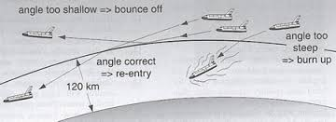
STEELBRICK SALES PROCESS*
Sales Stage | Identified - 5% | Discovery - 10% | Qualified - 20% | Evaluation - 30% (Trial - 35%)
Sales Activities | Discovery Call - Schedule and conduct Discovery Call (or FVC) Ask discovery (QST) questions Determine SFDC AE, SI, etc. | First Vision Call - Schedule, prep for and conduct FVC Personalize ATL and demo talk track to prospect based on discovery, products they sell, etc. Position our key differentiators and recommended evaluation path Identify Decision Maker & potential Insider/Champion | Determine appropriate Evaluation Path (see next page) Evaluation Plan - Complete Eval Plan with sponsor (+ Trial Success Criteria and Product/ Pricing Template if applicable) Quote - Send budgetary Quote for Licenses only (if requested) | Based on Eval Path, queue up: Admin Demo Personalized Demo Trial SVA Services Assessment - Send out SA Set up/Conduct Scoping Call Proposal - Send/Present full Proposal for Licenses + Services (+ SOW)
Stage Criteria (Verifiable Outcomes) | Identified an active project and completed call with indirect contact (i.e. SFDC Rep, Consultant or BDR) Able to fill in basic QST info Clear next steps, obtaining introduction and actively working to get into the opportunity | Completed Discovery Call High level fit & Vision Lock (“This could be interesting and a good fit, let’s get into more details…”) Agreed on Next Steps, most likely FVC scheduled | Completed FVC call Achieved Vision Lock - Confirmed fit to requirements, active project, budget and general time frame Agreed on Next Steps | Completed Eval plan / success criteria (work backward from Go-Live) and confirmed via email (For Trials - Kicked off Trial and Trial in progress)
Support | BDR | N/A | SE, AVP | SE, AVP, Services

Slide 8
STEELBRICK SALES PROCESS
Sales Stage | Identified - 5% | Discovery - 10% | Qualified - 20% | Evaluation - 30% (Trial - 35%) | Proposal - 45% (SVA - 50%) | Selection - 80% | Contract - 90% | Closed/Won - 100%
Sales Activities | Discovery Call - Schedule and conduct Discovery Call (or FVC) Ask discovery (QST) questions Determine SFDC AE, SI, etc. | First Vision Call - Schedule, prep for and conduct FVC Personalize ATL and demo talk track to prospect based on discovery, products they sell, etc. Position our key differentiators and recommended evaluation path Identify Decision Maker & potential Insider/Champion | Determine appropriate Evaluation Path (see next page) Evaluation Plan - Complete Eval Plan with sponsor (+ Trial Success Criteria and Product/ Pricing Template if applicable) Quote - Send budgetary Quote for Licenses only (if requested) | Based on Eval Path, queue up: Admin Demo Personalized Demo Trial SVA Services Assessment - Send out SA Set up/Conduct Scoping Call Proposal - Send/Present full Proposal for Licenses + Services (+ SOW) | Close the Technical Sale - Identify and address any final technical questions/ requirements Set up any: Customer References Executive Alignment/Intros Approvals - Submit any approval requests Ask for Selection | Order Form - Send Order Form with link to Standard MSA Approvals - Submit any Approval requests | Confirm Standard MSA won’t need to be reviewed OR request comments from customer legal team on MSA Approvals - Submit any Approval requests Order Form - Send Order Form via DocuSign | Request additional info from customer such as Implementation, Support and Billing Contact info Reach out to SFDC AE to get SFDC Org ID
Stage Criteria (Verifiable Outcomes) | Identified an active project and completed call with indirect contact (i.e. SFDC Rep, Consultant or BDR) Able to fill in basic QST info Clear next steps, obtaining introduction and actively working to get into the opportunity | Completed Discovery Call High level fit & Vision Lock (“This could be interesting and a good fit, let’s get into more details…”) Agreed on Next Steps, most likely FVC scheduled | Completed FVC call Achieved Vision Lock - Confirmed fit to requirements, active project, budget and general time frame Agreed on Next Steps | Completed Eval plan / success criteria (work backward from Go-Live) and confirmed via email (For Trials - Kicked off Trial and Trial in progress) | Delivered full proposal with licenses and services (For SVA’s - Completed SVA and delivered report out) | Received email confirmation on Selection (we are the preferred vendor pending commercial/ legal negotiations) | Preferred - Received email confirmation that Agreement won’t need to be reviewed OR if can’t sell around - Received comments from customer legal team on MSA. (Always send PDF and suggest they add comments in email). | Received signed Agreements by Customer via DocuSign
Support | BDR | N/A | SE, AVP | SE, AVP, Services | SE, AVP, CSM, Exec Team, Deal Desk | AVP, Deal Desk, Sales Ops | AVP, Deal Desk, Legal, Sales Ops | Accounting

Slide 9
Scoping Overview SalesforceCPQ
CoE Playbook
October 2016
Confidential

Slide 10

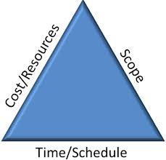
Our Scoping Approach
Enablement
High Customer involvement
Customer and SteelBrick participate in joint orientation & design sessions
Timeline based on Customer’s ability to deliver & configure
Standardization
Use out-of-the-box functionality and avoid customization & code
Customer learns best practices using next generation CPQ
Customer drives internal processes changes*
Iterative approach
Start configuring week 1 using pre-built and base functionality
Short and repeatable Design-Build-Validate cycles
Parallel tracks across functionality

Slide 11

1. Prepare for a Scoping Call
Source the appropriate scoping resource
Sound understanding of SalesforceCPQ capabilities
Prior implementation and scoping experienced preferred
Review information on the Opportunity
Opportunity – ACV, licenses, etc.
Account - Industry – What do they sell – Check their web site
Services Assessment - Scoping
How much of the work the client is willing to take on?
Identify areas of potential complexities
Develop leading questions for the call
If not already available, obtain from AE/SE:
Quote Samples
Approval matrices

Slide 12

Scoping Call Principles
Know your audience
Avoid technical terms or concepts if you have only business stakeholders in the audience
Always stay at the business process level – this is high level design session
Use the client’s terminology, as much as possible
Explain SteelBrick concepts whenever necessary, to avoid confusion
Understand the drivers behind the requirements
Dig until you clearly understand the use cases
Ask “Why” instead of “How” or “What”
Keep asking “Why” until you understand the root requirements
Many clients think that they know the “How” and try to design the solution for us
Push for best practices
Prioritize
Be wary of “must have” vs. “nice to have” requirements
What must be implemented in phase 1?
What can be pushed to a subsequent phase in order to get live faster?

Slide 13
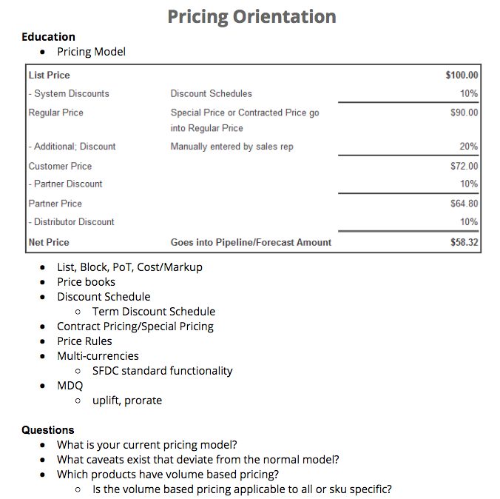
2. Execute the Scoping Call
Use Discussion Guide to facilitate the call
Follow a logical sequence for the major topics:
Products and Bundles
Pricing and Discounting
Approvals
Add-Ons/Amendments and Renewals
Quote Document and e-Signature

Slide 14
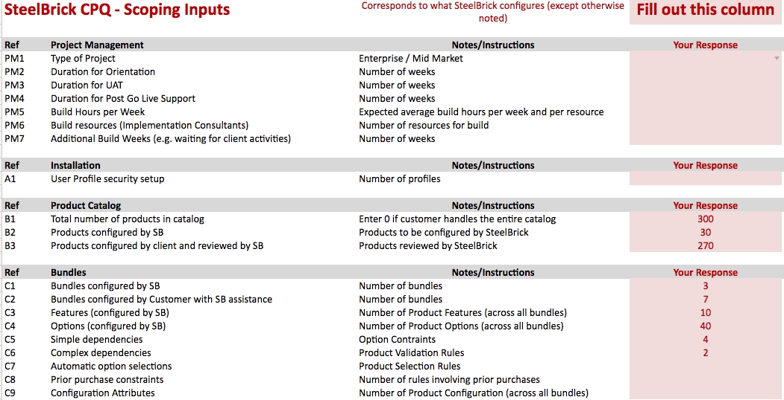
3. Use the Estimator
The Estimator spreadsheet is a mathematical model calculating the estimated number of hours to implement the client’s requirements
It covers most of the typical activities performed during a Salesforce CPQ implementation
Steps involved:
Respond to the questionnaire
Verify the resulting estimate
Decide whether or not assumptions of the mathematical model need to be adjusted, and how.
Consider adding buffers whenever necessary, as a last resort for adjustments

Slide 15
4. Produce the Scope of Work (SOW)
The SOW defines what SteelBrick and the client are respectively responsible for during implementation.
Most of the content is pre-defined, and only needs to be adjusted with numbers: those you typically entered in the Questionnaire tab of the Estimator spreadsheet
Do not try to re-invent the wheel!
Complex use cases involving several moving parts in SteelBrick can benefit from being clearly stated in the SOW. In such a case, start by a short summary of the use case, and present the solution as a bulleted list of artifacts that will be implemented.
Presenting the use case in the SOW will contribute demonstrating to the prospect that we understand their business and their needs.
In case of customizations, you MUST present the use case first.
Then include a bulleted list of the major parts of the solution
Only provide detailed information if it brings value.
For example, you might include specific mathematical formulas that are specific to the client
Remember your audience!
The reader of the SOW might not be technical. Most of the time, they are business stakeholders.
The SOW is a selling tool in addition to being a scoping document. Make sure it’s very clear, and nothing is vague.

Slide 16
Implementation Tactics SalesforceCPQ
CoE Playbook
October 2016
Confidential

Slide 17
Implementation Team
Role | Responsibility
Project Manager (PM) | Manages customer expectations Manages scope, resources, timeline, budget
Solution Architect (SA) | Provides design consultation Outlines the detailed technical approach
Implementation Consultant (IC) | Implements the technical design Responsible for building and unit testing Responsible for overall Quality
Customer Success Manager (CSM) / Customer Success Analyst (CSA) | Introduces client to project team Provides account level oversight Re-introduced at project completion to transition Support
Confidential

Slide 18
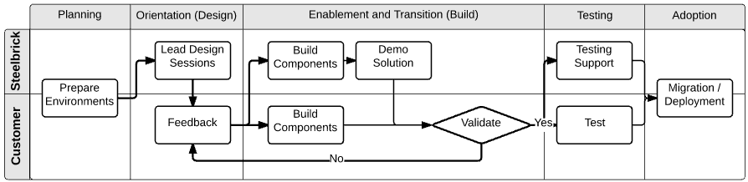
Implementation Methodology
Planning
Orientation/Design
Enablement & Transition/Build
Testing
Adoption
Confidential

Slide 19
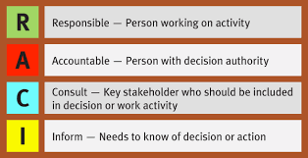
Implementation Methodology
RACI Matrix
Confidential

Slide 20
Implementation Methodology: Planning Phase
PM Tasks
# | Activity | Description | CSM | PM | IC | SA | Cust
1 | Review Order Form and SOW | Assure it exists on the Opportunity > Docs | A | R | - | - | -
2 | Coordinate an internal Sales/PreSales handoff meeting | Knowledge transfer items: demo org, hot topics in the Sales discussions, incumbent systems, known disturbances, opportunity areas, project charters, initial assessment of resources involved, scoping estimate spreadsheet | A | R | A | A | -
3 | Assure project is set up in PSA | Check with PS OPS, verify elements, hours and budget | A | R | - | - | -
4 | Create SmartSheet workspace | Project plan, Task List, Defect Log, Risk/Issues Log | I | R | - | - | -
5 | Hold the CSM On-boarding Meeting | CSM will organize and coordinate, PM must be present at this meeting | R | A | - | - | A
6 | Plan and execute the PM to PM meetings to discuss Week 0 objectives | PM to lead discussion, try scheduling at three separate sessions (M,W,F) in Week 0 for this discussion – billed time | I | R | - | - | A
Confidential

Slide 21

Customer Orientation
Introductory call with SteelBrick team
Account Exec (AE) Handoff
Customer Success (CSM/CSA) Introduction
Project Prep
Identify Key Customer Contacts
Collect Billing & PO Information
Resource Discussion
Important Dates
Training Class, Week 0 Target, Project Kickoff Target, Go-Live Target, etc.
Project Manager (PM) Introduction (if necessary)
Getting Started Workbook
Data Readiness Discussion
Follow-up and Schedule Week 0 / Project Kickoff Call
Confidential

Slide 22
Implementation Methodology: Planning Phase
Week 0 Checklist
Week 0: PM to PM Meeting Agenda items for Project Readiness. Objective: Get client ready for project by properly setting expectations at the start.
Topic | Expectation
Go Live Date | Determine if proposed dates from SOW are still feasible
Scope of Work | Review all items to be included in project (SOW), emphasize any SFRs and/or customizations that may be in scope
Project Governance | Establish counterpart customer PM and Sponsorship resources so proper channels of escalation are in place
Product Training | Verify customer has sent or scheduled resources to attend SteelBrick Product Training
Getting Started Workbook | Determine when the workbook can be completed, provide guidance if needed (include quote template & finalized approval matrix)
Draft Quote Template | Customer should have a draft developed of how templates should look before the Template workshop is held. The earlier a draft is provided the better to get the standard created (any changes can be dealt with by change order)
Finalized Approval Matrix | Customer should have the final approval matrix completed
Legacy Data Handling* | Determine and agree on the level of effort and plan to address any legacy data requirements (*Necessary for Renewals)
Testing, Migration & Training Strategy* | Prepare resources in advanced needed to support a robust testing, migration and training strategy
Identify External Influences that could impact the project | Influences beyond the project control may include: Alignment of new product/pricing releases Marketing Rebranding efforts CRM/ERP/Content Management projects Internal custom development Resourcing (ie. constraints at month/qtr end, PTO) SB Billing
*All Week 0 items MUST be completed in order to Kickoff Project and move on to Orientation/Design sessions.

Slide 23
Implementation Methodology: Planning Phase
PM Tasks
If Week 0 items are discussed and workbook completed to expectation, then:
# | Activity | Description | CSM | PM | IC | SA | Cust
7 | Assign Resource to Project | PM to notify Services Director to staff | I | R | C | C | -
8 | Prepare Kick-off Deck | Use presentation to provide overview of SOW and timeline to a larger audience | I | R | C | C | -
9 | Schedule Kick-off | Include project sponsors, client SMEs and implementation team | I | R | A | A
10 | Schedule Initial Workshop sessions | Products/Pricing/Bundles sessions should be planned Week 1 immediately after the Kick-off. Set expectations that workbook will be used as basis of the sessions. Progress on these sessions will dictate sprint build/scope during the build phase. | I | R | A | A | A
Otherwise:
# | Activity | Description | CSM | PM | IC | Arc | Cust
11 | Place Project on Hold and provide action plan | Update task list with outstanding items. Communicate CSM will be managing communication until ready | A | R | - | - | A
12 | CSM to manage | Establish regular touch points with customer to progress them to a readiness state | R | A | - | - | A

Slide 24

Implementation Methodology: Orientation/Design Phase
Project Kick-Off
Project Kick-Off signals Official Start of Implementation Work:
Scheduled upon completion of Week 0 tasks and Product Training class
Includes Project sponsors, Customer SME’s (Subject Matter Experts), and Project Implementation Team
Review Implementation Schedule
Review Project Scope
Timeline & Governance Finalized
Hear from Customer Sponsor
Confidential

Slide 25
Implementation Methodology: Orientation/Design Phase
Initial Design Workshops
# | Activity | Description | PM | IC | SA | Cust
13 | Project Kickoff | See Previous Slide | R | A | A | A
14 | Lead Initial design sessions | Consult SOW. Recommended focus for first sessions are Product, Pricing and Bundles. Leverage the workbook in the discussions. Look to establish what is needed to build first bundle, secure the price book, pricing and discounting strategy needed for project. | A | R | R | A
15 | Validate and Provide Feedback | Customer needs to verify solution is meeting business requirements | A | C | C | R
16 | Internally evaluate initial feedback | 1. PM to identify any risk/issues in from any of the feedback and sessions 2. IC/Arc to communicate to PM: Assessment of resources Potential scope/design/build challenges Define realistic build scope for initial sprint | A | R | R | A
17 | Update plan and documentation | 1. Refine the project plan and carve out the build iterations 2. Start to capture the technical solution either by updating workbook having the customer generate use cases or user stories | R | A | A | C
18 | Disseminate initial build items | PM will assign build task. SB resources should build first iterations. *Next iterations should have customer and partner involved | R | A | A | A
Confidential

Slide 26
Implementation Methodology: Build Phase
Initial Build Workshops
# | Activity | Description | PM | IC | SA | Cust
19 | Build Components | Recommended focus for first sessions are Product, Pricing and Bundles. Leverage the workbook in the discussions. Look to establish what is needed to build first bundle, secure the price book, pricing and discounting strategy needed for project. | A | R | R | R
20 | Unit Test | Customer needs to verify solution is meeting business requirements | A | R | R | R
21 | Plan Internal Demo | IC/Arc to demo build to PM prior to demoing to customer Mandatory for Partner ICs | A | R | R | -
22 | Schedule Sprint Demo | PM can secure time for demo with customer | R | A | A | A
**Design & Build sprints are happening in parallel until requirements are met, and within the build timeframe
Confidential

Slide 27
Implementation Methodology: Build Phase
Build & Demo
# | Activity | Description | PM | IC | SA | Cust
23 | Demo the Solution | PM should secure time for demo with customer – First demo should focus on Products, Pricing and Bundles – Subsequent Demo’s should focus on requirements as they are captured and built | A | R | R | A
24 | Validate and provide Feedback | Customer needs to verify solution is meeting business requirements – Validation is contact throughout build phase. | A | A | A | R
25 | Internally evaluate initial feedback | 1. PM to identify any risk/issues in from any of the feedback and sessions 2. IC/Arc to communicate to PM: Assessment of resources Potential scope/design/build challenges Define realistic build scope for next build sprint | A | R | R | A
26 | Update plan and documentation | 1. Refine the project plan and carve out the build iterations 2. Capture the technical solution either by updating workbook having the customer generate use cases or user stories | R | A | A | C
27 | Schedule subsequent design sessions | Consult SOW, recommended focus for second sessions are Approvals, Quote Template, Contracting and any SFR/Customizations. Leverage the workbook in the discussions. Establish what is needed to build for next iteration | R | A | A | A
Confidential

Slide 28
Implementation Methodology: Design/Build Phase
Secondary Design & Build
# | Activity | Description | PM | IC | SA | Cust
28 | Lead secondary design sessions | Consult SOW, recommended focus for second sessions are Approvals, Quote Template, Contracting and any SFR/Customizations. Leverage the workbook in the discussions. Establish what is needed to build for next iteration | A | R | R | A
29 | Provide Feedback | Customer needs to verify solution is meeting business requirements | A | A | A | R
30 | Internally evaluate feedback | 1. PM to identify any risk/issues in from any of the feedback and sessions 2. IC/Arc to communicate to PM: Assessment of resources Potential scope/design/build challenges Define realistic build scope for initial sprint | A | R | R | A
31 | Update plan and documentation | 1. Combine feedback from the initial demo and secondary design session and plan out remaining build for sprints. 2. Capture the technical solution either by updating workbook or having the customer generate use cases or user stories | R | A | A | C
32 | Disseminate remaining build items accordingly thru the sprints | PM will assign build task. SB resources should build first iterations. *Next iterations should have customer and partner involved | R | A | A | A
**Repeat design/build sprints until requirements have been met and validated by customer (under the defined project timeframe and parameters as noted in the SOW)
33 | Solicit end-user feedback on design & build | Secure and document the design approach, obtain customer validation on build and hand over build | R
Confidential

Slide 29
Implementation Methodology: Build Phase
Strategy Discussions
**These strategy discussions are best held after technical solution is hardened, generally this is clear after the second iteration.**
# | Activity | Description | PM | IC | SA | Cust
34 | Finalize Training Strategy | Determine with Client when best time to start creating training material Validate with the client who will be delivering training and when and where to train user base Leverage CSM to this discussion | R | C | C | A
35 | Finalize Migration Strategy | Consult the SOW and verify how (manual or Migration Center) and who will be performing the migration If SB is performing migration manually the IC/Architect and Client technical resource will need to develop a Migration Plan | R | C | C | A
36 | Finalize Testing Strategy | Establish Client is responsible for creating Use Cases/Test Cases Establish Client is responsible for executing testing Determine defect tracking process, by default create a defect tracking log in SmartSheet Establish communication plan and cadence during the testing process | R | C | C | A
Confidential

Slide 30
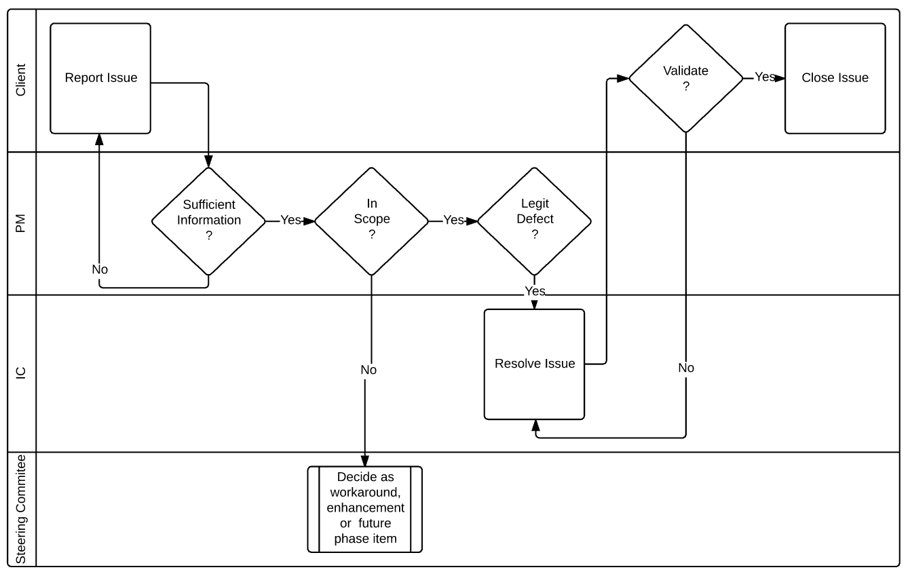
Implementation Methodology: Testing
Defect Testing Map

Slide 31
Implementation Methodology: Testing
UAT
# | Activity | Description | PM | IC | SA | Cust
37 | Perform UAT according to plan | Client applies testing resources to plan. Testers should document issues on defect list complete with appropriate detail (ie. Quote#, steps to replicate, user info, etc.) | A | C | C | R
38 | Triage Issue | Ensure issue has sufficient information. Characterize the issue: In or out of scope Legitimate defect Data Issue User Training | R | C | C | A
39 | Manage Defect List | Assign defects to ICs Schedule and lead regular defect calls to track progress | R | C | C | A
40 | Resolve defects | IC is responsible for: Understanding the defect Determining root cause Estimating ETA Applying corrective action Unit testing | I | R | C | A
41 | Validate fixes | Customer is responsible for: Validating the fix Closing the issue | I | A | C | R
Confidential

Slide 32
Implementation Methodology: Adoption
Migration & Go-Live
# | Activity | Description | PM | IC | Arc | Cust
42 | Code freeze | After resolution of defects freeze code to prevent regression impact | R | A | A | A
43 | Perform migration according to plan | Coordinate migration activities | A | R | I | R
44 | Validate in Production | Client should verify Use/Test Cases in production before allowing users access | A | A | A | R
45 | Re-introduce CSM to client | Plan a meeting and establish CSM and the point person for communication moving forward CSM should also provide Support access to Client | R | I | I | A
46 | Introduce post go-live Support process – PM to CSM Handoff Meeting | Plan a meeting and introduce Support Manager who will present the Support process | R | I | I | A
Confidential

Slide 33
What’s next?
Confidential

Slide 34
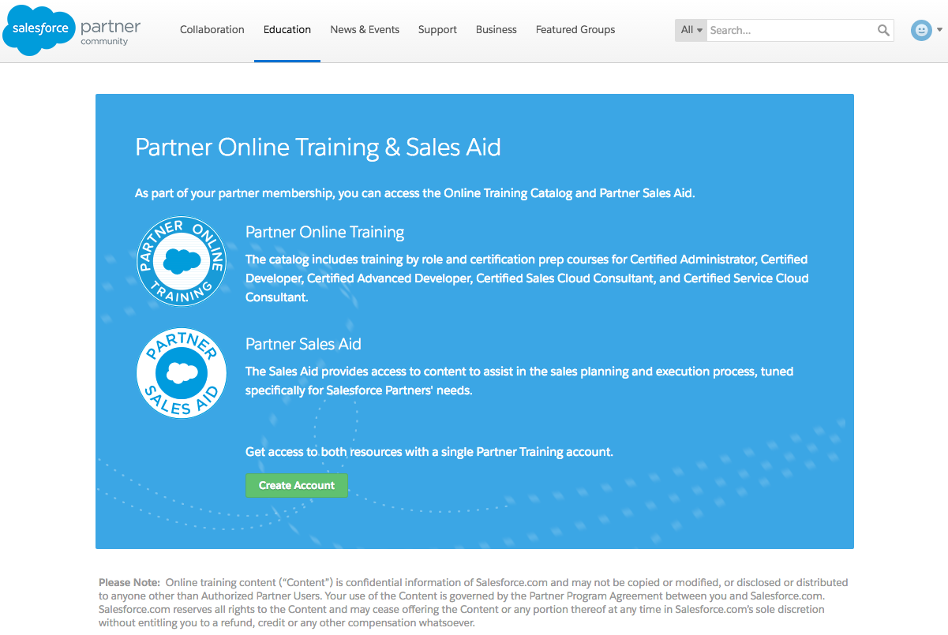
SteelBrick training in Salesforce Partner Community
Log in to the partner community at partners.salesforce.com
open up the URL p.force.com/lms
If you do not already have a partner training account you will be prompted to create one here (ie name@partnertraining.com user id)
From there you should be able to search the catalogue to locate the Steelbrick learning path and begin training (Be sure you are now logged in with your XXXX@partnertraining.com ID)

Slide 35
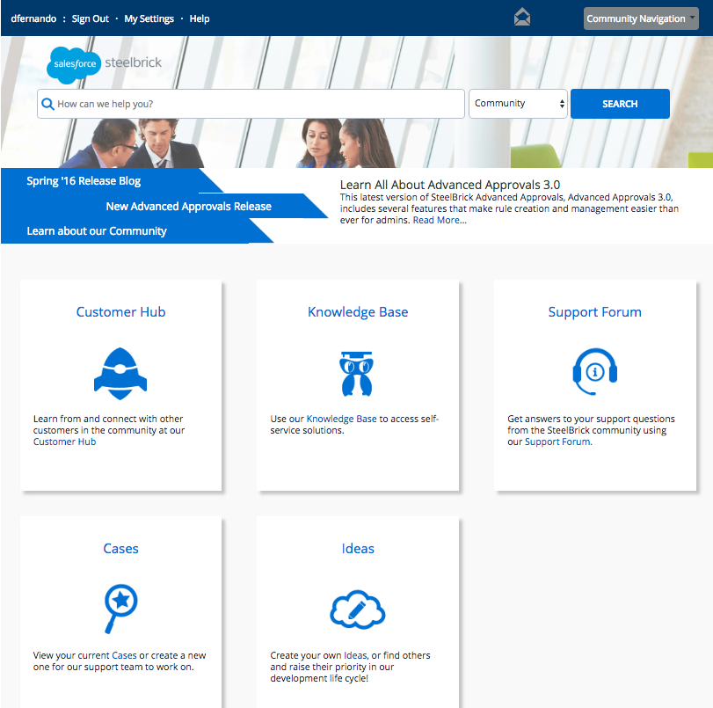
Access SteelBrick Knowledge base
Log in to: community.steelbrick.com
Knowledge base - access self service solutions
Support Forum - get an answers to typical support questions
Cases – create a support ticket
Ideas – prioritize our roadmap

Slide 36
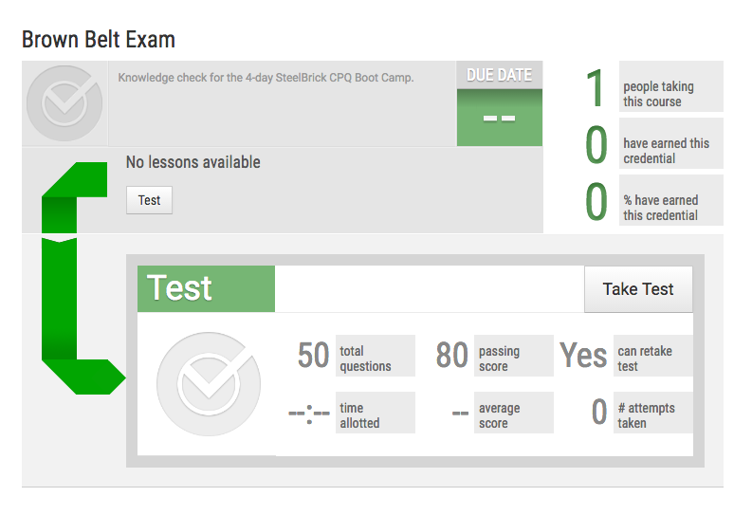

Take your Brown Belt Test
Log in to Learncore to take the Brown belt exam
50 questions, 80% to pass, retakes enalbled

